Slide 1
Best of Alan November
Greta Faurote

Slide 3
November Quote:
Teachers are more important than ever, they just don’t realize it.

Slide 4
Google Searches
Country codes
edu and ac
site:ir is an example

Slide 5
Prism
http://prism.scholarslab.org/prisms/be46faf6-a587-11e4-a767-c638e2d850fd/visualize?locale=en
http://tinyurl.com/y73dnsxl

Slide 6
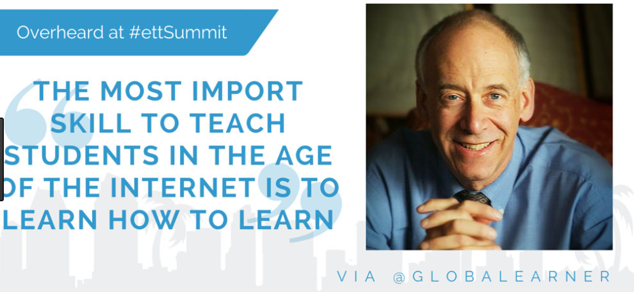
Global Network
Brainstorm Session

Slide 7
Alan November
https://www.youtube.com/watch?v=J41iN5gJt6w
https://linkinglearning.wordpress.com/2014/10/03/getting-real-with-web-evaluation-tips-and-tools-to-develop-information-literacy/

Slide 8
Google Scholar
Search Google Scholar

Slide 9
Way Back Machine
http://archive.org/web/

Slide 10
November Learning

