Slide 1
TECH TOOL SMACKDOWN
Jessica Hollingsworth
@J4Hollingsworth
jhollingsworth@kokomoschools.com

Slide 2
Agenda
Introduction to Instructor and Class Structure
SAMR
4 C’s
Smackdown
Reflection
Repeat

Slide 3
I am Jessica Hollingsworth
It isn’t about the technology tool….it is about the tasks and opportunities you can offer students by enhancing lesson using technology.
You can find me at @J4Hollingsworth or jhollingsworth@kokomoschools.com

Slide 4
SAMR

Slide 7
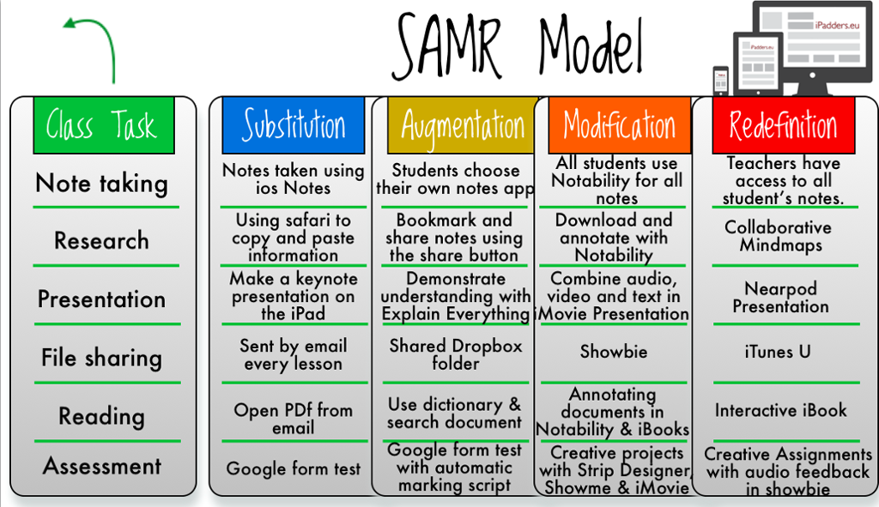

Slide 9
4 C’s

Slide 10
Video Link

Slide 11
Tip!
You may want to write down websites with corresponding usernames and passwords.

Slide 12
Let’s Start the Tech Tool Smackdown!

Slide 14
Thanks!
Any questions?
You can find me at @jhollingsworth@kokomoschools.com
Session Evaluation!

