Slide 1
Groups & Collaborative Tools in Canvas
Joy Dewing
Summer 2017

Slide 2
Introductions
Name
Where you teach
What you teach
Why you’re interested in this session
Your current comfort level with Canvas
Something you want to read this summer

Slide 3
Canvas Groups
Assign students to groups

Slide 4
Canvas Groups
Assign students to groups
Can be used once or many times

Slide 5
Canvas Groups
Assign students to groups
Can be used once or many times
Allows student to work together on a Canvas assignment

Slide 6
Canvas Groups
Assign students to groups
Can be used once or many times
Allows student to work together on a Canvas assignment
Students only post assignment once

Slide 7
Canvas Groups
Assign students to groups
Can be used once or many times
Allows student to work together on a Canvas assignment
Students only post assignment once
Grade is copied for all students

Slide 8
Collaboration Tools
Links Canvas to Google Doc

Slide 9
Collaboration Tools
Links Canvas to Google Doc
Includes all aspects of Google Doc (seeing history, etc.)

Slide 10
Collaboration Tools
Links Canvas to Google Doc
Includes all aspects of Google Doc (seeing history, etc.)
More organized than “Sharing” on Google Docs

Slide 11
Collaboration Tools
Links Canvas to Google Doc
Includes all aspects of Google Doc (seeing history, etc.)
More organized than “Sharing” on Google Docs
Can be graded through Canvas and sent to Power School Gradebook

Slide 12
Benefits
Teacher creates topics

Slide 13
Benefits
Teacher creates topics
Assign groups

Slide 14
Benefits
Teacher creates topics
Assign groups
Uses tools students are familiar with

Slide 15
Benefits
Teacher creates topics
Assign groups
Uses tools students are familiar with
Provide different documents for different students

Slide 16
Benefits
Teacher creates topics
Assign groups
Uses tools students are familiar with
Provide different documents for different students
Differentiate

Slide 17
Some Uses
Discuss books and other texts

Slide 18
Some Uses
Discuss books and other texts
Work with students in other class periods

Slide 19
Some Uses
Discuss books and other texts
Work with students in other class periods
Cross-curricular discussions

Slide 20
Some Uses
Discuss books and other texts
Work with students in other class periods
Cross-curricular discussions
Plan research or projects

Slide 21
Some Uses
Discuss books and other texts
Work with students in other class periods
Cross-curricular discussions
Plan research or projects
Collaborative notes

Slide 22
Some Uses
Discuss books and other texts
Work with students in other class periods
Cross-curricular discussions
Plan research or projects
Collaborative notes
Other ideas?

Slide 23
Examples
My Canvas page and Sandbox page

Slide 24
Play Time
How can you use the collaboration tool in your classroom?
Choose 1 unit or lesson that you teach and develop a collaboration activity for it

Slide 25
Share
What did you create?
What will you take with you?

Slide 26
Information Literacy Standards
American Library Association: http://www.ala.org/acrl/issues/infolit/standards/steps#structure
The information literate student:
1. determines the nature and extent of the information needed.
2. accesses needed information effectively and efficiently.
3. evaluates information and its sources critically and incorporates selected information into his or her knowledge base and value system.

Slide 27
Information Literacy Standards
American Library Association: http://www.ala.org/acrl/issues/infolit/standards/steps#structure
The information literate student:
4. individually or as a member of a group, uses information effectively to accomplish a specific purpose.
5. understands many of the economic, legal, and social issues surrounding the use of information and accesses and uses information ethically and legally. This standard recognizes that students must be taught the social, economic and political issues surrounding information, specifically the ethical and legal uses of information and its technology.

Slide 28
ISTE (International Society for Technology in Education) Standards
1. Creativity and Innovation Students demonstrate creative thinking, construct knowledge, and develop innovative products and processes using technology. | 2. Communication and Collaboration Students use digital media and environments to communicate and work collaboratively, including at a distance, to support individual learning and contribute to the learning of others. | 3. Research and Information Fluency Students apply digital tools to gather, evaluate, and use information.
4. Critical Thinking, Problem Solving, and Decision Making Students use critical thinking skills to plan and conduct research, manage projects, solve problems, and make informed decisions using appropriate digital tools and resources. | 5. Digital Citizenship Students understand human, cultural, and societal issues related to technology and practice legal and ethical behavior. | 6. Technology Operations and Concepts Students demonstrate a sound understanding of technology concepts, systems, and operations.
http://www.iste.org/docs/pdfs/20-14_ISTE_Standards-S_PDF.pdf

Slide 29
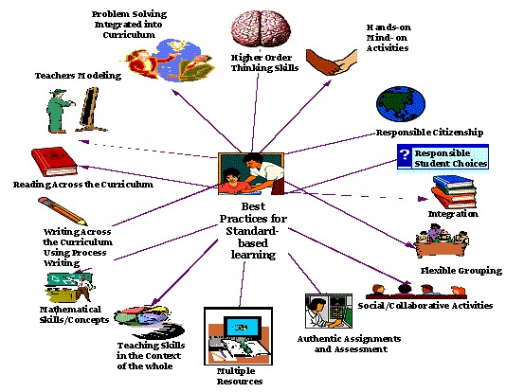
Best Practices

Slide 30
What’s next?
Share something you learned that you can use in your classroom this fall
Complete online survey

