Slide 1
What is Arts Integration?
Wallace School of Integrated Arts

Slide 2
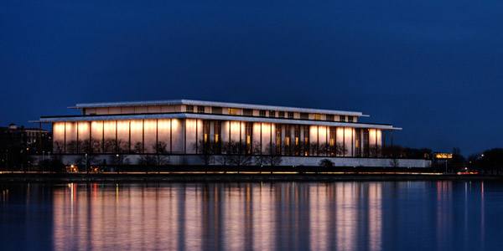
Kennedy Center
The Kennedy Center for the Performing Arts hosts a national arts integration conference each year.
Wallace staff has attended every year for the last 5 years
We have adopted their arts integration definition in our school

Slide 3
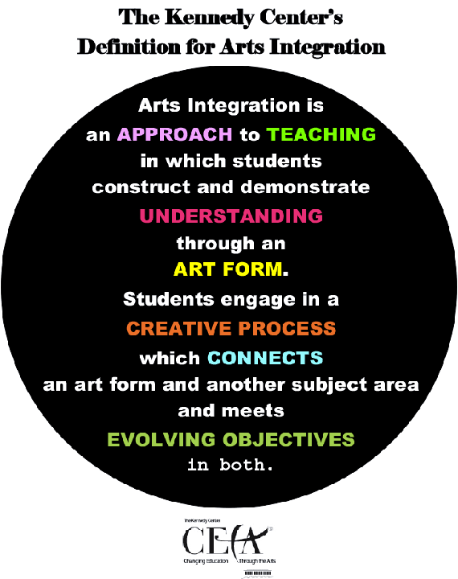

Slide 4
Approach to Teaching
Arts integration is not an activity thrown in here and there
It is a daily practice
Students use tableau for all subjects multiple times throughout the year
Notes:
Pass out pig parade lesson plan

Slide 5
Construct and Demonstrate Understanding
Students show that they understand what a detail is and what details are in the book
Can be used as formative or summative assessment
Can be paired with a written, oral, or visual piece
Pushes students to not only have knowledge but apply it

Slide 6
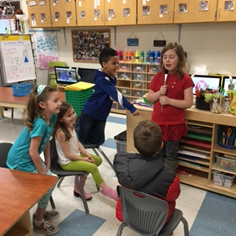
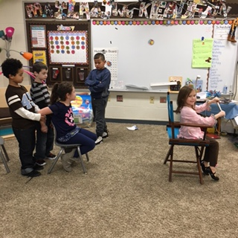
Through an Art Form
Drama

Slide 7
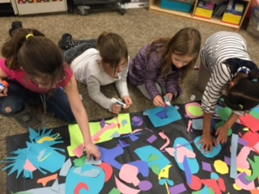
Creative Process
Students plan and create their work on their own with minimal input from the teacher
If it is copying teacher work it is not arts integration

Slide 8
Connects an Art Form and Subject Area

Slide 9
Meets Evolving Objectives
Students are growing in their understanding of main idea and details and their understanding of drama

Slide 10
Literacy Standards
K.RL.2.1 With support, ask and answer questions about main topics and key details in a text heard or read
1.RL.2.1 1 Ask and answer questions about main idea and key details in a text.
2.RL.2.1Ask and answer questions (e.g., who was the story about; why did an event happen; where did the story happen) to demonstrate understanding of main idea and key details in a text.
3.RL.2.1 Ask and answer questions to demonstrate understanding of a text, referring explicitly to the text as the basis for the answers.
4.RL.2.1 Refer to details and examples in a text when explaining what a text says explicitly and when drawing inferences from the text.
5.RL.2.1 Quote accurately from a text when explaining what a text says explicitly and when drawing inferences from the text.

Slide 11
Drama Standards
*.3.2 Identify and describe the character, plot, and setting in classroom dramatizations and/or formal productions
*.4.2 Speculate on the meaning of a performance
Standards are the same across grade levels

Slide 12
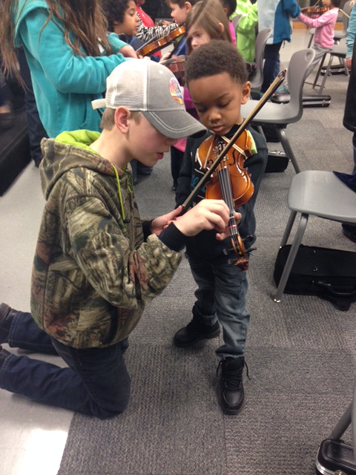
Types of Art Forms
Visual Art
Drama
Music
Dance

Slide 13
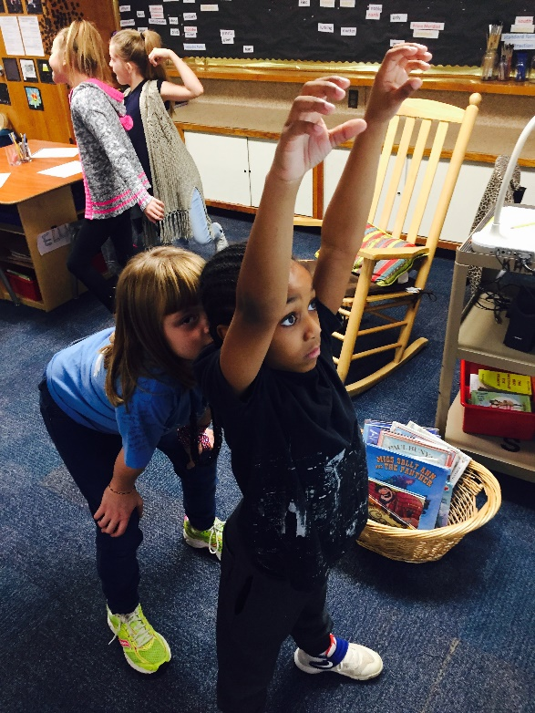
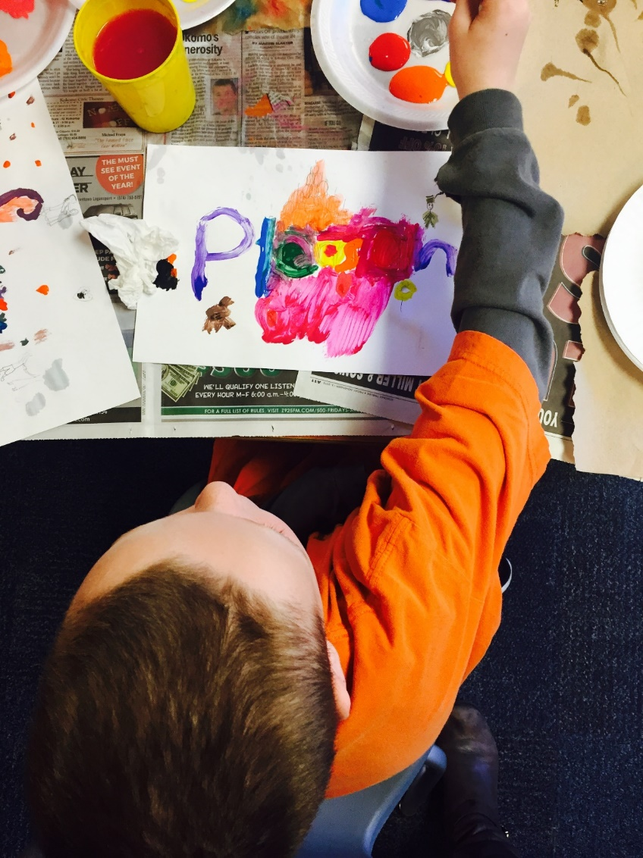
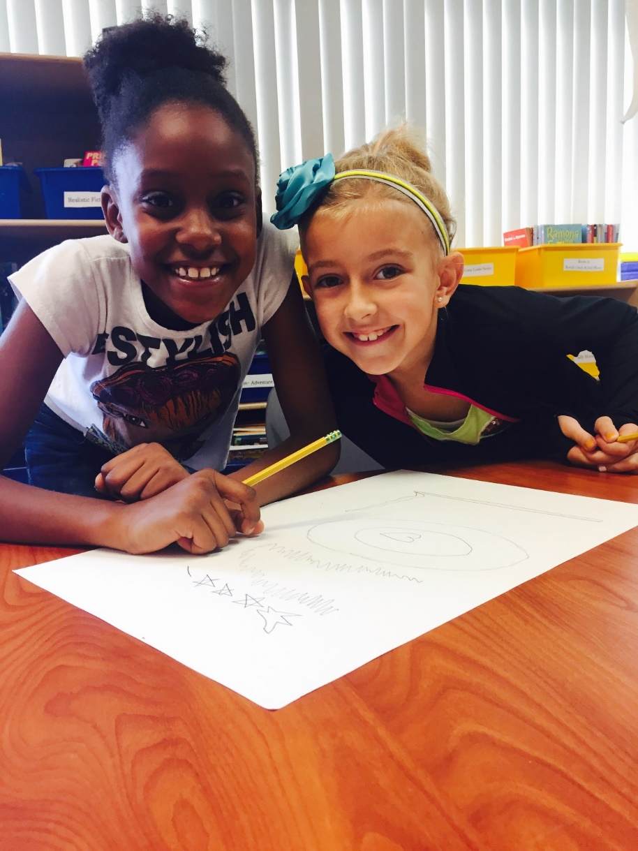
Why Arts Integration?
It is a unique tool for building understanding and assessment.
It is easily differentiated to allow all students to feel successful.
It helps students build teamwork skills.

Slide 14
How Does AI Fit in Kokomo?
We use the same curriculum maps, guides, and textbooks
We infuse art into the district initiatives

Slide 15
Break

Slide 16
Songwriting with Synonyms and Antonyms

Slide 17
Lesson Extensions
Synonyms, antonyms
Skip counting
Math facts
Parts of speech
Other Ideas?

Slide 18
Character Interviews

Slide 19
Lesson Extensions
Biographies
Inferences
Making Connections
Main Idea
Historical Events
Number Characteristics
Other Ideas?

Slide 20
Mondrian Math

Slide 21
Lesson Extensions
Patterns
Conversions
Measurement
Shape Recognition
Area and Perimeter
Other Ideas?

Slide 22
Lunch

Slide 23
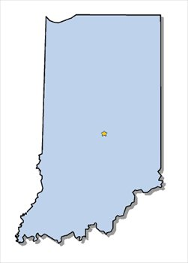
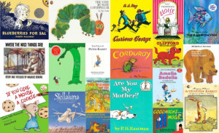
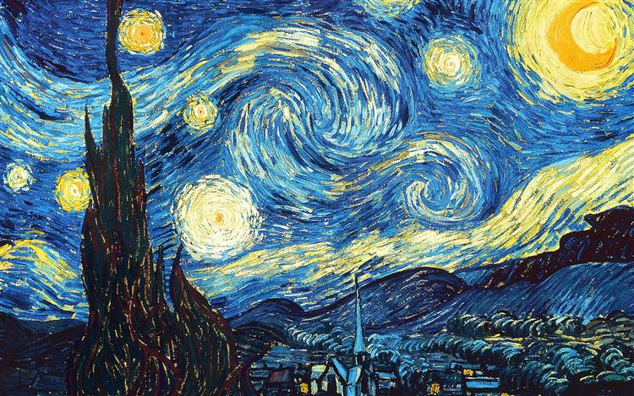
Internet Resources
(Pinterest, teacher blogs, arts organization websites, YouTube, arts integration websites. websites for and by artists)
Children’s Literature
State Standard
(Academic or Art)
Students
Arts Integration Lesson Inspiration Points
Collaboration with Colleagues/School Arts Specialist
Art Form, Work of Art, or Artist
Professional Development
Artistic Skills Already Built
(developmental-students already know how to use Tableau)

Slide 24
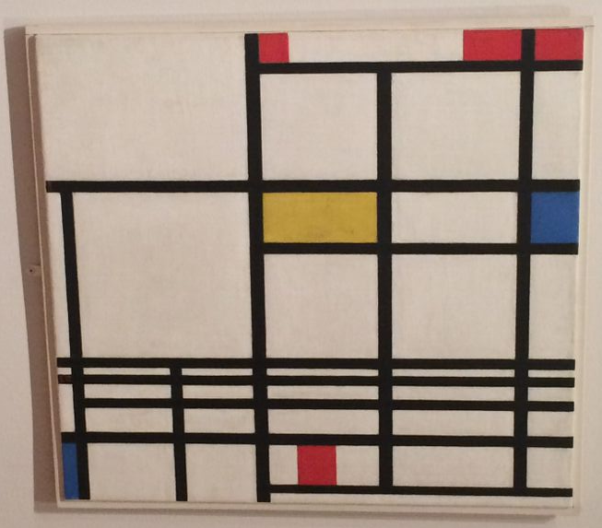
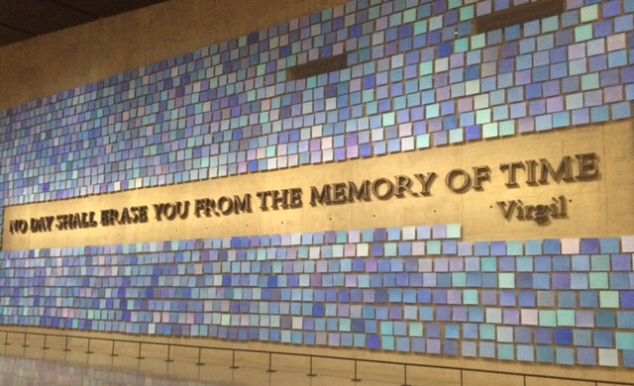
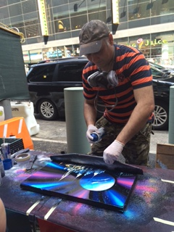
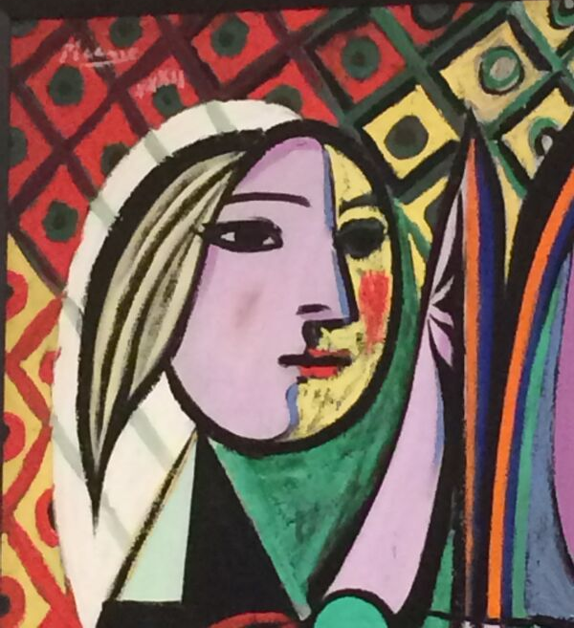
New York Inspiration

