Slide 1
Using Jokes, Comics, & Graphic Novels to Meet Literacy Standards
Joy Dewing
Summer 2017

Slide 2
Introductions
Name
Where you teach
What you teach
Why you’re interested in this session
What you’re hoping to learn today
A book you want to read this summer

Slide 3
“My greatest sorrow in my life is that I never did comics.” ~ Pablo Picasso

Slide 4
Using Comics in my Classroom: A Review
Conference in 2010
“Jokes and Graphic Novels” Bulletin boards
Supporting struggling readers
Extra credit
AP
Competing with Tom Ferguson
What’s next?

Slide 5
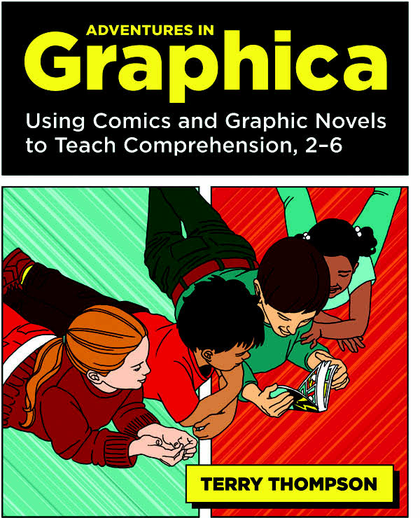
Conference in 2010
Terry Thompson Adventures in Graphica

Slide 6
Comic Competition: Joke of the Week
Tom Ferguson, the physics teacher

Slide 7
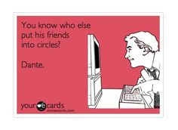

Slide 8
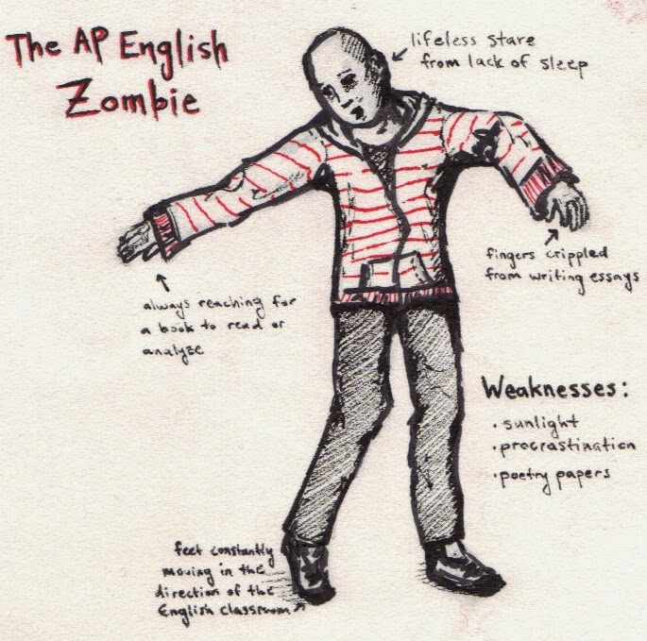

Slide 10
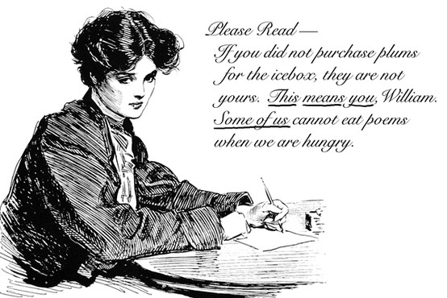

Slide 11
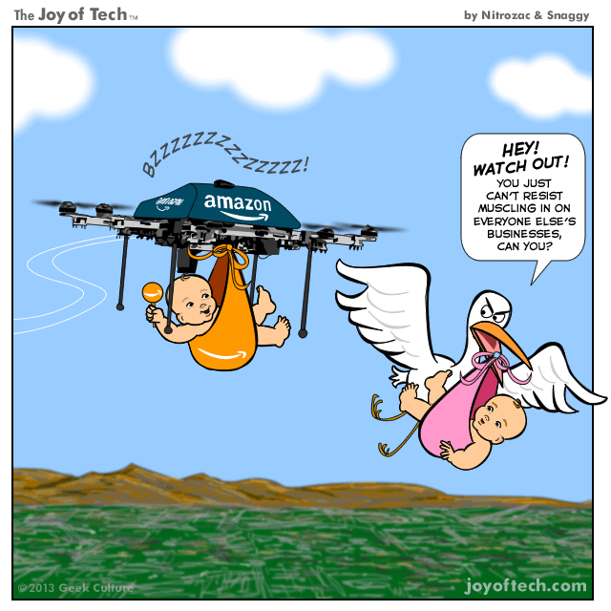

Slide 12
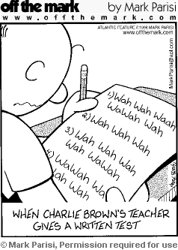
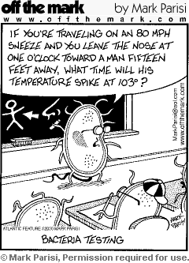

Slide 14
Why Use Comics?
Graphic Novels are becoming more and more popular, and better written

Slide 15
Why Use Comics?
Graphic Novels are becoming more and more popular, and better written
Conversations with students

Slide 16
Why Use Comics?
Graphic Novels are becoming more and more popular, and better written
Conversations with students
Assess comprehension and learning

Slide 17
Why Use Comics?
Graphic Novels are becoming more and more popular, and better written
Conversations with students
Assess comprehension and learning
Higher order thinking

Slide 18
Why Use Comics?
Graphic Novels are becoming more and more popular, and better written
Conversations with students
Assess comprehension and learning
Higher order thinking
Support struggling and reluctant readers

Slide 19
Research
Comics & Graphic Novels:
Are popular

Slide 20
Research
Comics & Graphic Novels:
Are popular
Provide linguistic support

Slide 21
Research
Comics & Graphic Novels:
Are popular
Provide linguistic support
Contain rare words; higher vocabulary than conversation

Slide 22
Research
Comics & Graphic Novels:
Are popular
Provide linguistic support
Contain rare words; higher vocabulary than conversation
Support reading development

Slide 23
Research
Comics & Graphic Novels:
Are popular
Provide linguistic support
Contain rare words; higher vocabulary than conversation
Support reading development
Increase student pleasure reading & create positive reading attitudes

Slide 24
Research
Comics & Graphic Novels:
Support struggling readers and ESL students

Slide 25
Research
Comics & Graphic Novels:
Support struggling readers and ESL students
Develop critical thinking skills

Slide 26
Research
Comics & Graphic Novels:
Support struggling readers and ESL students
Develop critical thinking skills
Increase reading motivation

Slide 27
Taking a look at comics:
What do you notice?
How is it organized?
How is it similar to/ different from other genres?

Slide 28
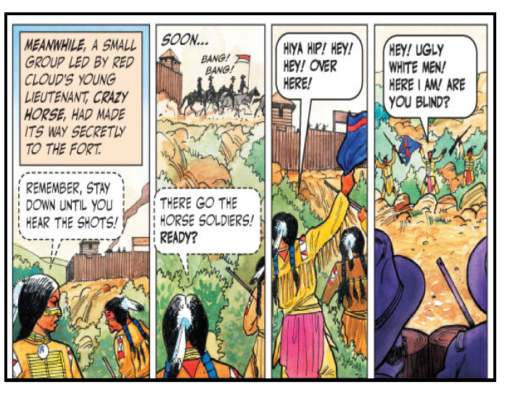

Slide 29
Taking a look at comics:
What do you notice?
How is it organized?
How is it similar to/ different from other genres?

Slide 30
Taking a look at comics:
What reading strategies did you use to comprehend it?

Slide 31
Taking a look at comics:
What do you notice about the vocabulary?
What supports struggling readers?

Slide 35
Uses in your classroom
Bellwork activities
Students write their own comics/ graphic novels
Accessible texts; use to teach a concept
Sequencing
Prewriting/ plot mountain
Story problems
Meeting specific standards
Assessment/ Pivot
Use with/ in place of more difficult texts
Other ideas?

Slide 36
Play Time
Find some comics to support your instruction
Find graphic novels for your content area

Slide 37
Share

Slide 38
Research Support/ Extended Reading
Adventures in Graphica by Terry Thompson
Teaching Graphic Novels by Katie Monnin

Slide 39
Information Literacy Standards
American Library Association: http://www.ala.org/acrl/issues/infolit/standards/steps#structure
The information literate student:
1. determines the nature and extent of the information needed.
2. accesses needed information effectively and efficiently.
3. evaluates information and its sources critically and incorporates selected information into his or her knowledge base and value system.

Slide 40
Information Literacy Standards
American Library Association: http://www.ala.org/acrl/issues/infolit/standards/steps#structure
The information literate student:
4. individually or as a member of a group, uses information effectively to accomplish a specific purpose.
5. understands many of the economic, legal, and social issues surrounding the use of information and accesses and uses information ethically and legally. This standard recognizes that students must be taught the social, economic and political issues surrounding information, specifically the ethical and legal uses of information and its technology.

Slide 41
ISTE (International Society for Technology in Education) Standards
1. Creativity and Innovation Students demonstrate creative thinking, construct knowledge, and develop innovative products and processes using technology. | 2. Communication and Collaboration Students use digital media and environments to communicate and work collaboratively, including at a distance, to support individual learning and contribute to the learning of others. | 3. Research and Information Fluency Students apply digital tools to gather, evaluate, and use information.
4. Critical Thinking, Problem Solving, and Decision Making Students use critical thinking skills to plan and conduct research, manage projects, solve problems, and make informed decisions using appropriate digital tools and resources. | 5. Digital Citizenship Students understand human, cultural, and societal issues related to technology and practice legal and ethical behavior. | 6. Technology Operations and Concepts Students demonstrate a sound understanding of technology concepts, systems, and operations.
http://www.iste.org/docs/pdfs/20-14_ISTE_Standards-S_PDF.pdf

Slide 42
Best Practices

Slide 43
What’s next?
Share something you learned that you can use in your classroom this fall
Complete online survey

