Slide 1
Newsela
Joy Dewing
Summer 2017

Slide 2
Introductions
Name
Where you teach
What you teach
Why you’re interested in this session
What you know about Newsela already
Something you want to do this summer

Slide 3
What is it?
Online archive of articles
Current events
Pre-created text sets

Slide 4
Benefits
Articles available at different reading levels
Includes reading comprehension quizzes
Teacher can add questions
Student can annotate online
Assesses students by standard
Easy to evaluate
Can link to Canvas

Slide 5
Newsela.com
Create an account
Create classes/ invite students with a link and class code

Slide 6
Share
Something you found on Newsela that you can use/ will work well in your classroom

Slide 7
Information Literacy Standards
American Library Association: http://www.ala.org/acrl/issues/infolit/standards/steps#structure
The information literate student:
1. determines the nature and extent of the information needed.
2. accesses needed information effectively and efficiently.
3. evaluates information and its sources critically and incorporates selected information into his or her knowledge base and value system.

Slide 8
Information Literacy Standards
American Library Association: http://www.ala.org/acrl/issues/infolit/standards/steps#structure
The information literate student:
4. individually or as a member of a group, uses information effectively to accomplish a specific purpose.
5. understands many of the economic, legal, and social issues surrounding the use of information and accesses and uses information ethically and legally. This standard recognizes that students must be taught the social, economic and political issues surrounding information, specifically the ethical and legal uses of information and its technology.

Slide 9
ISTE (International Society for Technology in Education) Standards
1. Creativity and Innovation Students demonstrate creative thinking, construct knowledge, and develop innovative products and processes using technology. | 2. Communication and Collaboration Students use digital media and environments to communicate and work collaboratively, including at a distance, to support individual learning and contribute to the learning of others. | 3. Research and Information Fluency Students apply digital tools to gather, evaluate, and use information.
4. Critical Thinking, Problem Solving, and Decision Making Students use critical thinking skills to plan and conduct research, manage projects, solve problems, and make informed decisions using appropriate digital tools and resources. | 5. Digital Citizenship Students understand human, cultural, and societal issues related to technology and practice legal and ethical behavior. | 6. Technology Operations and Concepts Students demonstrate a sound understanding of technology concepts, systems, and operations.
http://www.iste.org/docs/pdfs/20-14_ISTE_Standards-S_PDF.pdf

Slide 10
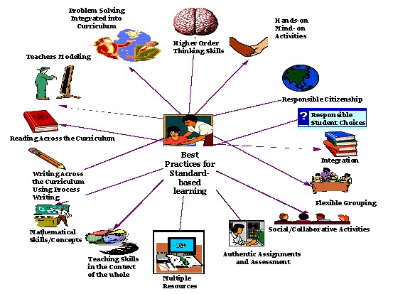
Best Practices

Slide 11
What’s next?
Share something you learned that you can use in your classroom this fall
Complete online survey

