Slide 1
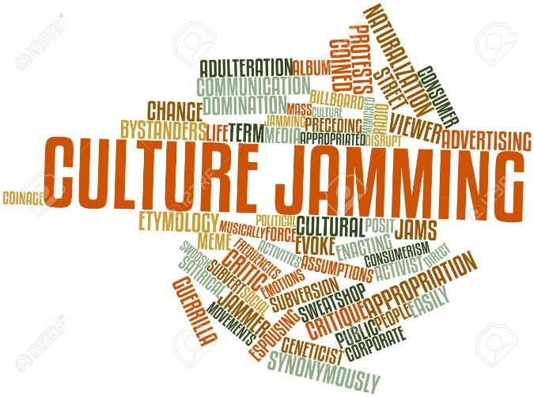
Culture Jamming: Teaching in an Inclusive Environment
Presenter: Dr. Joanne Barnes
Professor: PhD Organizational Leadership
Dean, Graduate School-Indiana Wesleyan University
©Barnes 2017

Slide 2
Culture Jamming: Removing Barriers and Developing Inclusive Leaders and Organizational Cultures
Introduction of workshop
Overview of Implicit/Unconscious Bias
Opening Activity
Visual of Culture Jamming
Questions and Answers

Slide 3
Culture Jamming: Removing Barriers and Developing Inclusive Classroom
Culture Jamming
From Culture Jamming to Inclusive Classroom
Perspective activity (Diverse Universe)
Debrief activity
Small Group Table Conversations
Wrap-up/Summary

Slide 4
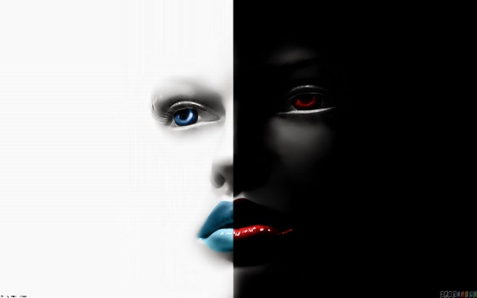
Implicit and Unconscious Bias
Definition: Unconscious bias is a social stereotype about certain groups of people that are formed outside one’s own awareness.
1. Often incompatible with one’s conscious values
2. Certain scenarios can activate unconscious attitudes and beliefs
Navarro, R. Vice Chancellor of Diversity & Outreach, University of California-San Francisco, transcript on unconscious bias, n.d.
Notes:
Brad: This was submitted in the proposal
Unconscious bias refers to a bias that we are unaware of, and which happens outside of our control. It is developed at an early age and continues throughout our life span (Dore, Hoffman, Lillard, & Trawalter, 2014). Biases happens automatically and are triggered by our brain making quick judgments and assumptions of people and situations, influenced by our background, cultural environment and personal experiences. Unconscious biases have real world effects on behavior (Dasgupta, 2004). They are malleable and one can take steps to minimize their impact (Dasgupta, 2013; Dasgupta & Greenwald, 2013). Many of our perceptions of individuals who are diverse from ourselves (race, gender, ethnicity, socio-economic and age) are formed based on stereotype-based beliefs (Kunda & Thagard, 1996). These beliefs are often highlighted when one interacts with an individual who is different from themselves. The actions can be associated with unconscious bias. These behaviors may result in negative treatment of the diverse members of the team and entire organization. Often stereotypical beliefs are developed through the use of media and political views that often portray societal groups in a negative light. As one continues to be exposed to these views, the greater the influence they have on one’s beliefs, where leaders may (consciously or unconsciously) create a less inclusive organizational environment.

Slide 5
Unconscious Bias Impedes One’s Cultural Development
Negative cultural stereotypes about a group can develop a strong association between that group and a social label.
Creates hundreds of seemingly irrational circumstances daily
Ross, H. (2008). Exploring unconscious bias. Diversity Best Practices, 2(5), 1-18
Uhlmann, E. L., & Nosek, B. A. (2011). My culture made me do it: Lay theories of responsibility for automatic prejudice.
Notes:
Brad: This was submitted in the proposal
Unconscious bias refers to a bias that we are unaware of, and which happens outside of our control. It is developed at an early age and continues throughout our life span (Dore, Hoffman, Lillard, & Trawalter, 2014). Biases happens automatically and are triggered by our brain making quick judgments and assumptions of people and situations, influenced by our background, cultural environment and personal experiences. Unconscious biases have real world effects on behavior (Dasgupta, 2004). They are malleable and one can take steps to minimize their impact (Dasgupta, 2013; Dasgupta & Greenwald, 2013). Many of our perceptions of individuals who are diverse from ourselves (race, gender, ethnicity, socio-economic and age) are formed based on stereotype-based beliefs (Kunda & Thagard, 1996). These beliefs are often highlighted when one interacts with an individual who is different from themselves. The actions can be associated with unconscious bias. These behaviors may result in negative treatment of the diverse members of the team and entire organization. Often stereotypical beliefs are developed through the use of media and political views that often portray societal groups in a negative light. As one continues to be exposed to these views, the greater the influence they have on one’s beliefs, where leaders may (consciously or unconsciously) create a less inclusive organizational environment.

Slide 6
Perception Bias
The tendency to form stereotypes about certain groups
It becomes impossible to make objective judgments about members of those groups
Question: “To what extent are our organizational cultures and business results being affected by unconscious bias?”
McCormick, H. (2015). The real effects of unconscious bias in the workplace, UNC Executive Development, www.execdev.unc.edu.
Notes:
Brad: This was submitted in the proposal
Unconscious bias refers to a bias that we are unaware of, and which happens outside of our control. It is developed at an early age and continues throughout our life span (Dore, Hoffman, Lillard, & Trawalter, 2014). Biases happens automatically and are triggered by our brain making quick judgments and assumptions of people and situations, influenced by our background, cultural environment and personal experiences. Unconscious biases have real world effects on behavior (Dasgupta, 2004). They are malleable and one can take steps to minimize their impact (Dasgupta, 2013; Dasgupta & Greenwald, 2013). Many of our perceptions of individuals who are diverse from ourselves (race, gender, ethnicity, socio-economic and age) are formed based on stereotype-based beliefs (Kunda & Thagard, 1996). These beliefs are often highlighted when one interacts with an individual who is different from themselves. The actions can be associated with unconscious bias. These behaviors may result in negative treatment of the diverse members of the team and entire organization. Often stereotypical beliefs are developed through the use of media and political views that often portray societal groups in a negative light. As one continues to be exposed to these views, the greater the influence they have on one’s beliefs, where leaders may (consciously or unconsciously) create a less inclusive organizational environment.

Slide 7
Culture Jamming
Is used to challenge or disrupt dominant discourse with a dose of subversion and creativity
Notes:
Misty, this was submitted in the proposal:
Culture jamming has been used in the arts, politics and media as a way to reimage stereotypes. In media, cultural jamming seeks “to achieve transparency, that is, to mitigate the asymmetrical effects of power and other distortions in the communications apparatus” (p. 118). Culture jamming is used to remove the negative image of individuals or groups and present a more positive one. The importance for leaders to foster an inclusive environment cannot be overstated. However, culture jamming used by itself is not enough to change the organizational culture and environment. Culture jamming paired with cultural intelligence and responsiveness can equip leaders to create an inclusive organizational culture.

Slide 8
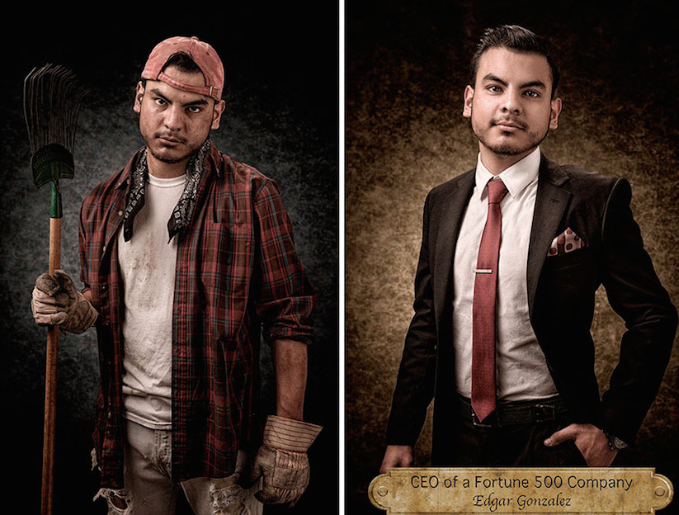

Slide 9
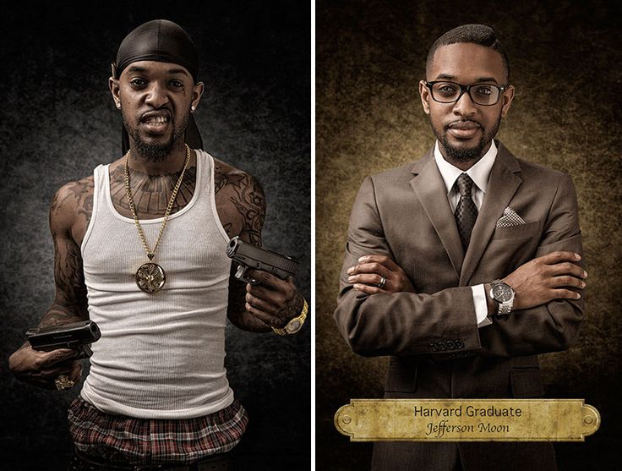

Slide 10
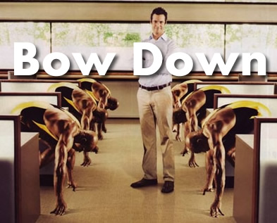

Slide 11
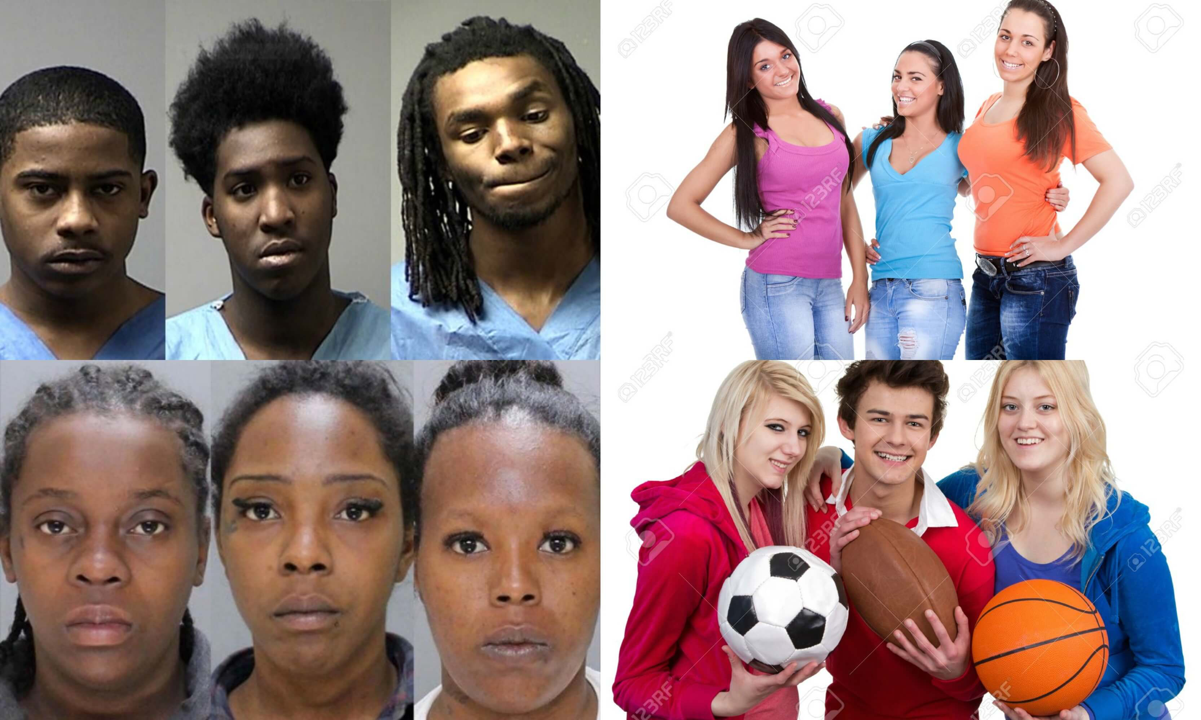

Slide 12
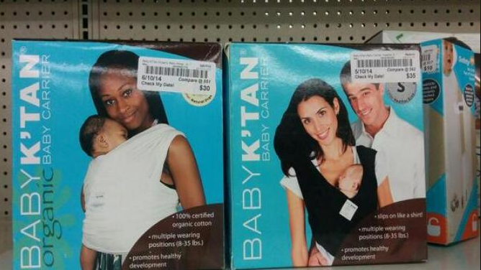

Slide 13
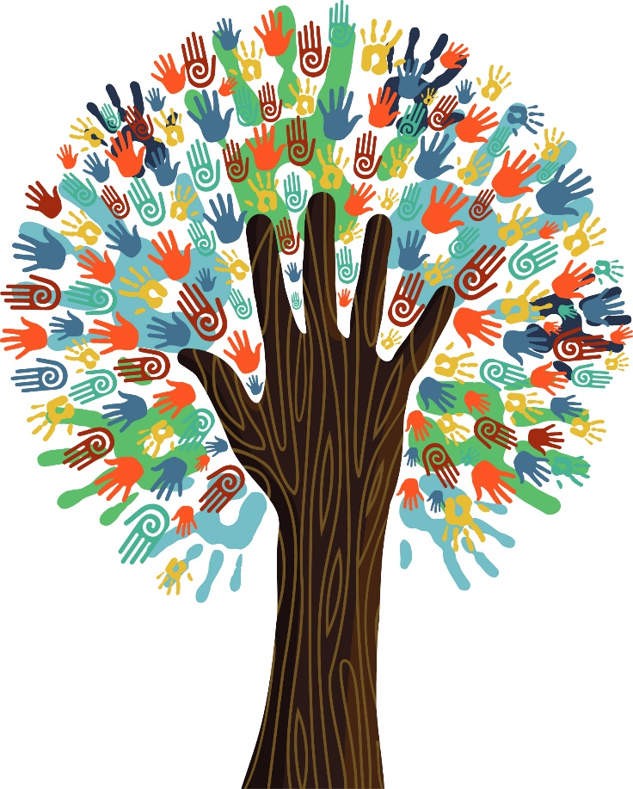
From Culture Jamming to Inclusive Classroom
Inclusive leadership
Culturally Inclusive Leadership
Organizational Inclusive Leadership
Diverse World:
Really???
Notes:
Cultural responsiveness refers to the leader’s ability to gain knowledge from people who are not only from a different culture than theirs, but also from their own culture. In addition to gaining knowledge, the leader learns how to effectively relate with diverse members through respect, thus leading to an inclusive organizational culture. Cultural jams (Martinez, 2012), a form of culturally responsive teaching allows organizational leaders to be more effective in interactions with diverse groups and individuals.
A four-dimension cultural intelligence model entails metacognitive, cognitive, motivational, and behavioral components (Amiri, Moghimi, & Kazemi, 2010). Two of these components, cognitive and motivational, incorporate the acquisition of cultural knowledge along with an internal drive to experience new and different cultures. Behavioral CQ focuses on one’s ability to relate through verbal/nonverbal actions effectively which leads to unbiased communication with diverse members of the organization.

Slide 14
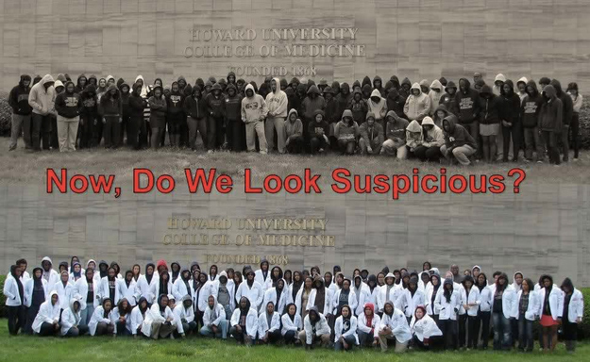
My Culture Made Me Do It
Notes:
Read excerpt from article: briefly explain how it relates to the workshop and culture jamming.
Some years ago one of the authors was flipping through a copy of the New Haven Register and came across a photo of a couple of men loitering on a street corner. The first, an African American man, held a plastic bag filled with some illicit substance, and the second, a Hispanic man, smiled at the camera through a mouthful of gold teeth. He glanced down at the caption, mildly curious as to what these two
hoodlums had been arrested for. The caption read: “They Deliver: Desmond Bent, left, of Connecticut Job Corps and Ray Vasquez of the Community Action Agency deliver meals to the residents of Imperial Apartments Friday in New Haven.” Eric Luis Uhlmann and Brian A. Nosek
2012

Slide 15
How Diverse is Your Universe?
Bead Colors:
Blue – Anglo
Yellow – Latino/Latina
Red – African American
Green – Asian
Brown - Other

Slide 16
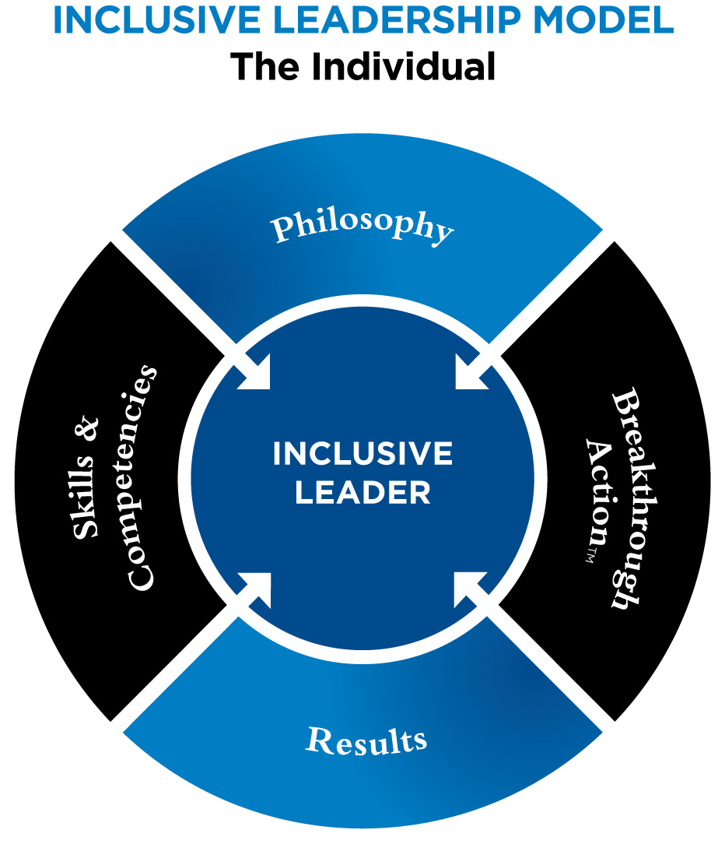
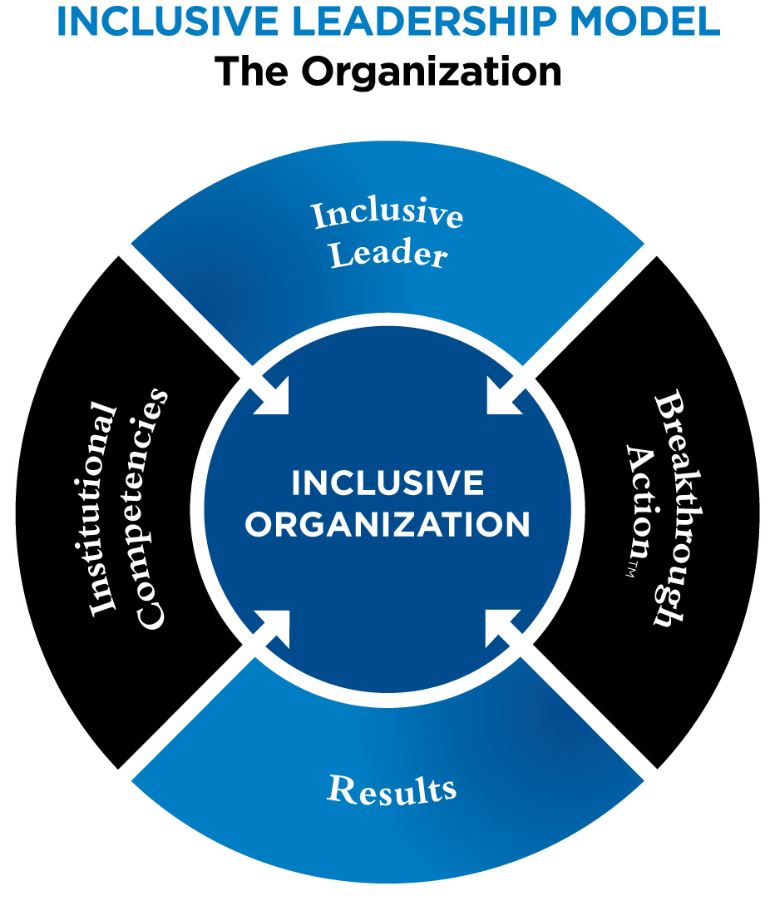
Two Models of Inclusive Leadership The Teacher as the Leader
National Urban Fellows, n.d.
Notes:
http://www.nuf.org/inclusive-leadership-model
Philosophy
Inclusive Leaders start with the development of a conscious philosophy of leadership, articulating their values and style. Respect, integrity and courage are cornerstones of an inclusive leadership philosophy.
Skills and Competencies
Key skills must include cultural competence, systems thinking, group facilitation, organizational development, strategic planning and implementation, communication and financial acumen.
Breakthrough Action
Leadership is a natural capacity that requires breakthrough rather than learning. Breakthrough Action is a “systems”-based leadership practice implemented by consciously applying three principles: being responsible, being self-reflective and being committed to collective leadership (the leadership development of others).
Results
The capacity to make promises and deliver results consistent with those promises defines effective leadership. A focus on results drives leaders to continuously evaluate and improve outcomes in support of their objectives. Results-driven leaders are inclusive when they ensure that diverse voices are included, contribute to and benefit from the results.
THE ORGANIZATION
Inclusive Leader
At the core is a leader with a well articulated personal leadership philosophy, who is competent in key skill areas including cultural competence and systems thinking. Inclusive organizational leaders are deliberate in their practice of Breakthrough Action and develop organizations with a structure to consistently expand their mission capacity and produce effective results. Inclusive Organizations begin and end with inclusive leadership.
Institutional Competencies
Key competencies must include strategic planning, organizational assessment/development, education/training, inclusive/integrated Human Resource systems, an inclusive culture, adaptability, networking, coaching and mentoring. Organizations that establish these competencies must also create structures to constantly expand and update them to be truly effective.
Breakthrough Action
Organizations are more likely to build and apply competencies if their culture is characterized by responsibility, internal assessment, feedback and a demonstrated commitment to developing each employee and stakeholder as a leader. These practices sustain organizations even when they lack particular competencies. Breakthrough Action is the practice of taking responsibility for and action to acquire and apply missing competencies.
Results
Action and producing results must be an integral part of the culture of any Inclusive Organization. Simply asking the question, “What results have we produced?” can usefully shift the direction and process of any organization as a whole. A focus on results is essential for organizations to maintain a successful commitment to inclusivity. If the structure and process are not inclusive the results will likely lack the inclusivity that defines success at all levels of public service leadership.

Slide 17
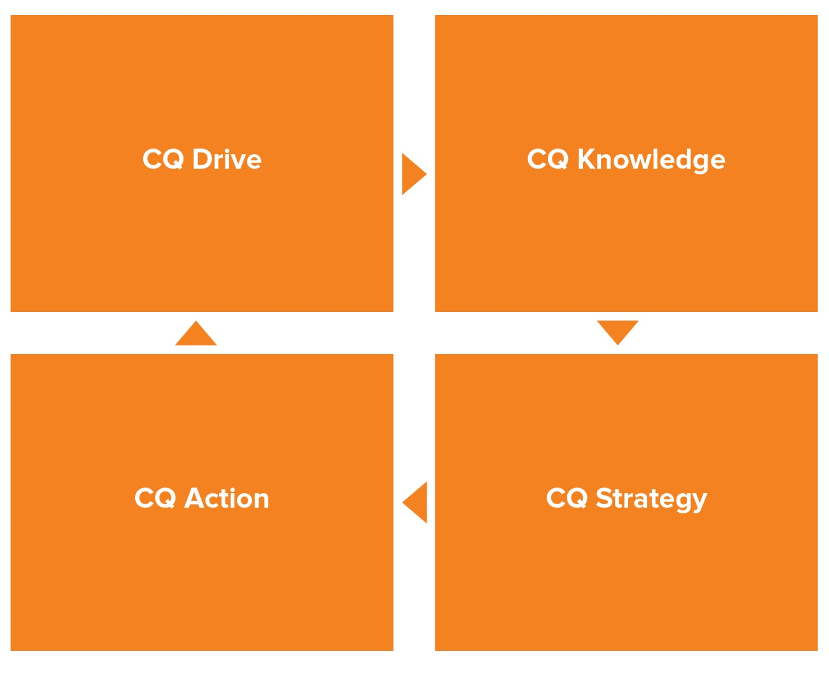
Cultural Intelligence: Culture Jamming & Inclusivity
CQ Model
Notes:
The capability to function effectively across various cultural contexts (national, ethnic, organizational, generational, etc.).
--Soon Ang and Linn Van Dyne, “Conceptualization of Cultural Intelligence” in Handbook of Cultural Intelligence: Theory, Measurement, and Applications (Armonk, NY: M.E. Sharpe, 2008), 3.
Research reveals that the culturally intelligent—Individuals who effectively accomplish their objectives regardless of the cultural context—have strengths in four key capabilities.
The four capabilities of cultural intelligence are CQ Drive, CQ Knowledge, CQ Strategy, and CQ Action. They can also be thought of as four steps to developing CQ.
CQ Drive (motivation) is your interest, drive and confidence to adapt to a multicultural situation.
CQ Knowledge (cognition) is your understanding about how cultures are similar and different.
CQ Strategy (meta-cognition) is your awareness and ability to plan for multicultural interactions.
CQ Action (behavior) is your ability to adapt when relating and working interculturally.

Slide 18
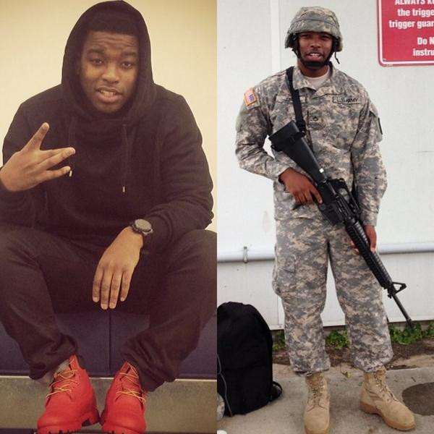
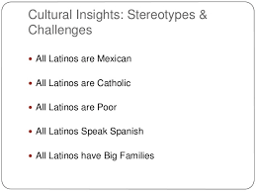
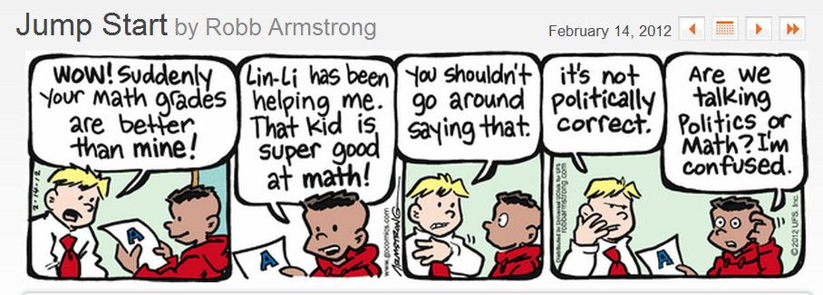
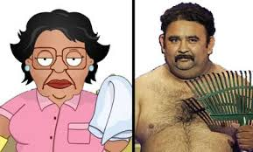
Backpack Full of Jam’s, Inclusive and CQ
My Perceptions
My Biases
Myth Versus Truth
Chaos/Confusion
Backpack exercise

Slide 19
Small Group Discussions
Group One: Where were you?
Group Two: Circles of my multicultural self
Group Three: Moving Forward

Slide 20
Summary
This workshop has covered
Culture jamming
Unconscious bias
Inclusiveness
Cultural Intelligence
Processes enable us to remove stereotypical bias that we do not often recognize and become more inclusive.

Slide 21
Culture Jamming
Get Active

